Slide 1


micro:bit entry video tutorial
Lesson 10
micro:bit sensor lesson 10 “Electronic organ”
YahBoom micro:bit module tutorial

Slide 2
micro:bit entry video tutorial
Content
Part1
Part 2
Part3
Part 4
Part 5
Learning goals
Preparation
Connection
Search for blocks
Combine blocks
YahBoom micro:bit module tutorial

Slide 3
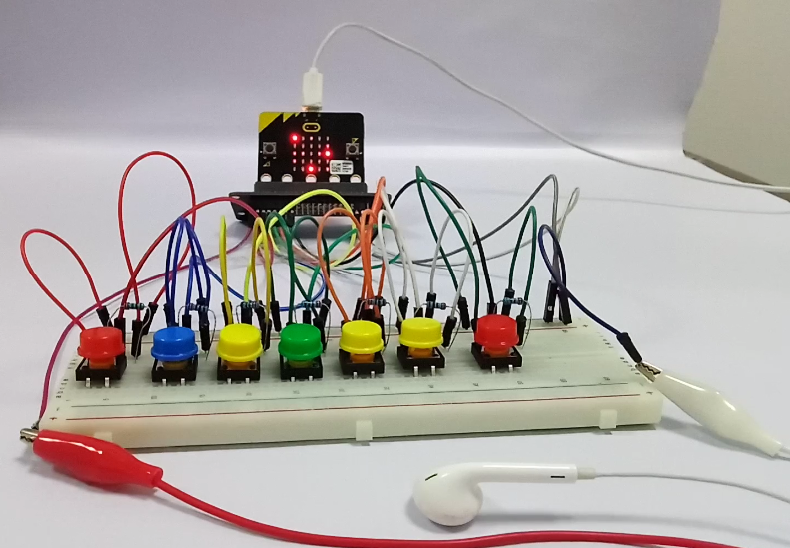
micro:bit entry video tutorial
Part 1
Learning goals
After you download the program, you can play the nice music with 7 buttons.
With earphones, you can hear your own music.
YahBoom micro:bit module tutorial

Slide 4
micro:bit entry video tutorial
Part 2
Hardware:
● 1 X Micro: bit Board
● 1 X Micro USB Cable
● 1 X Micro:bit breakout
● 1 X 830 holes breadboard
● 7 X Colorful button
● 15 X Male to male cable
● 10 X Female to male cable
● 1 X earphone
● 2 X Crocodile clip line
● 7 X resistor
● 1 X PC
Preparation
Then the micro:bit is connected to the computer through USB, and the computer will pop up a U disk and click the URL in the U disk to enter the programming interface.
YahBoom micro:bit module tutorial

Slide 5
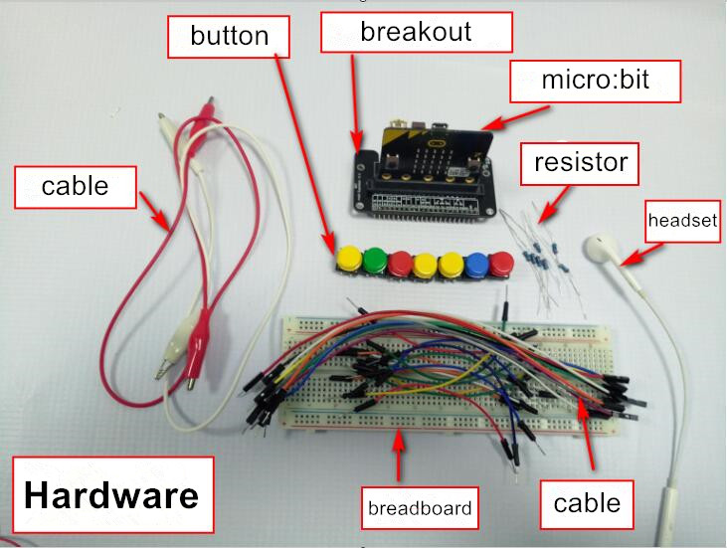
micro:bit entry video tutorial
Part 3
Connection
YahBoom micro:bit module tutorial

Slide 6
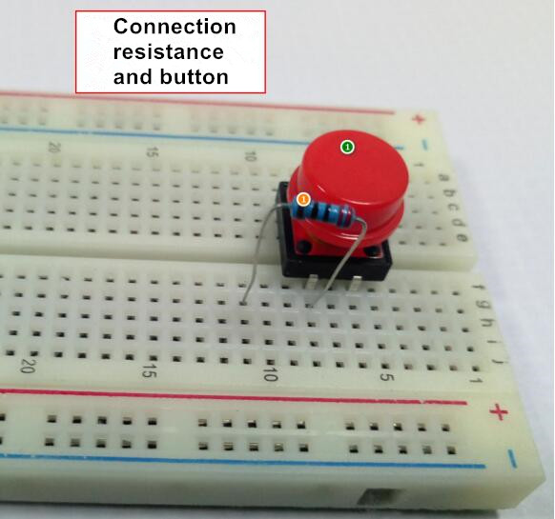
micro:bit entry video tutorial
Part 3
The green number is a color button
The orange number represents the resistance
The blue number represents the DuPont line
The rose red number represents the crocodile clip
Connection
YahBoom micro:bit module tutorial

Slide 7
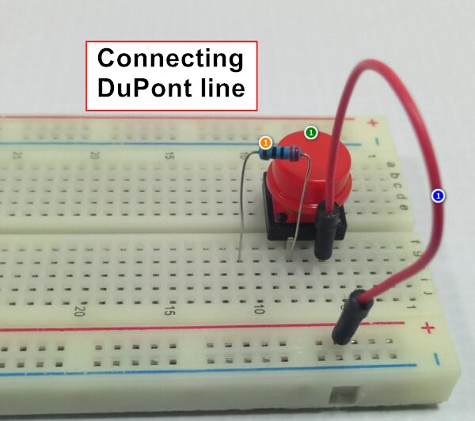
micro:bit entry video tutorial
Part 3
Connection
YahBoom micro:bit module tutorial

Slide 8
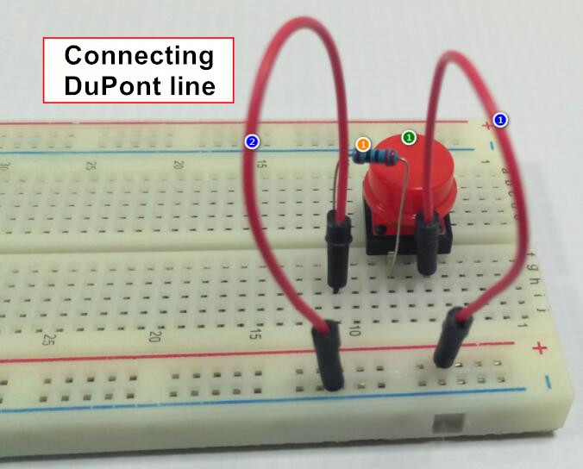
micro:bit entry video tutorial
Part 3
Connection
YahBoom micro:bit module tutorial

Slide 9
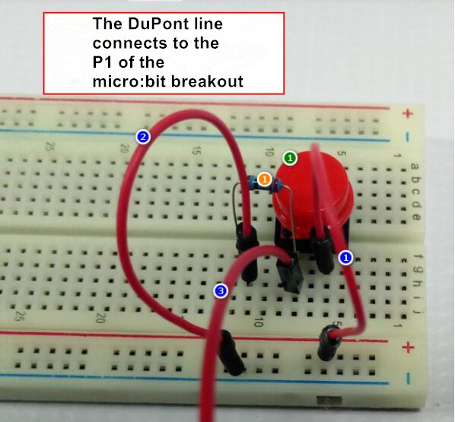
micro:bit entry video tutorial
Part 3
The other 6 color buttons are the same.
Connection
YahBoom micro:bit module tutorial

Slide 10
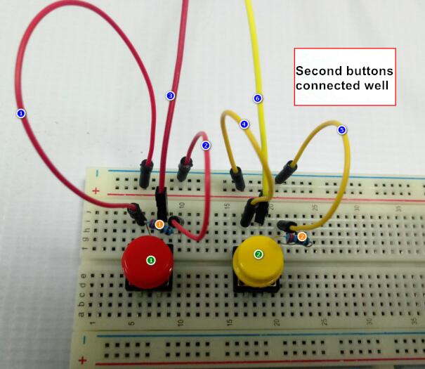
micro:bit entry video tutorial
Part 3
Wiring is quite complicated, but we must be serious and get it right.
Connection
YahBoom micro:bit module tutorial

Slide 11
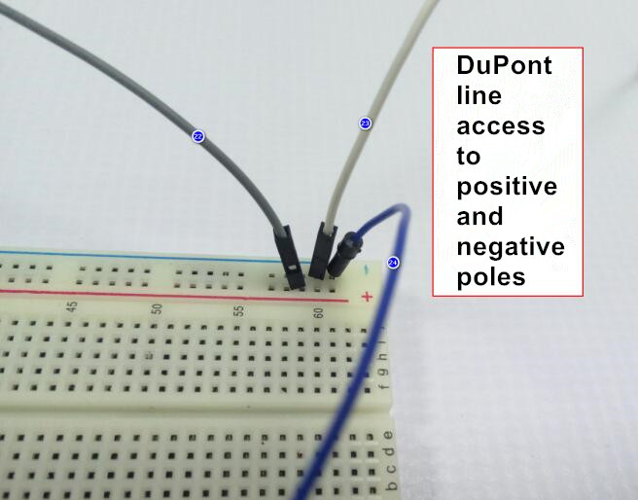
micro:bit entry video tutorial
Part 3
Connection
YahBoom micro:bit module tutorial

Slide 12
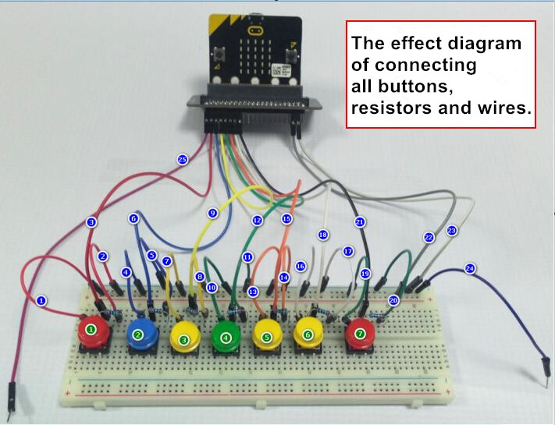
micro:bit entry video tutorial
Part 3
Connection
YahBoom micro:bit module tutorial

Slide 13
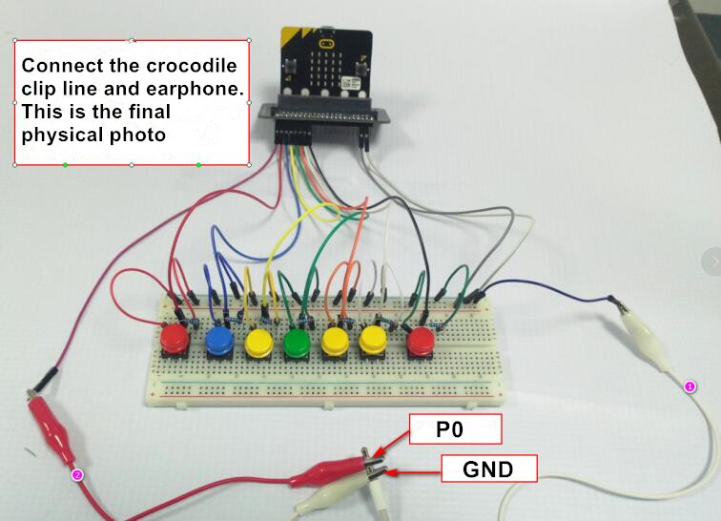
micro:bit entry video tutorial
Part 3
Connection
YahBoom micro:bit module tutorial

Slide 14
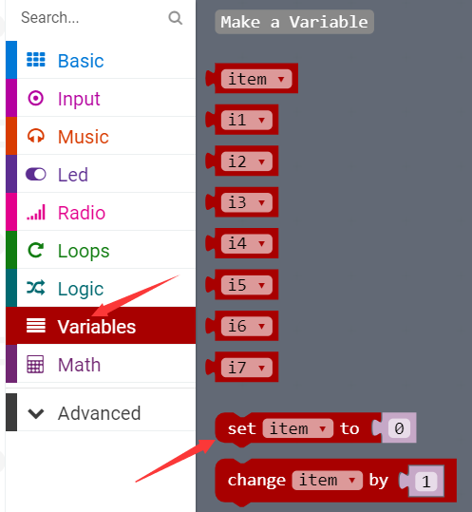
micro:bit entry video tutorial
Part 3
Search for blocks
YahBoom micro:bit module tutorial

Slide 15
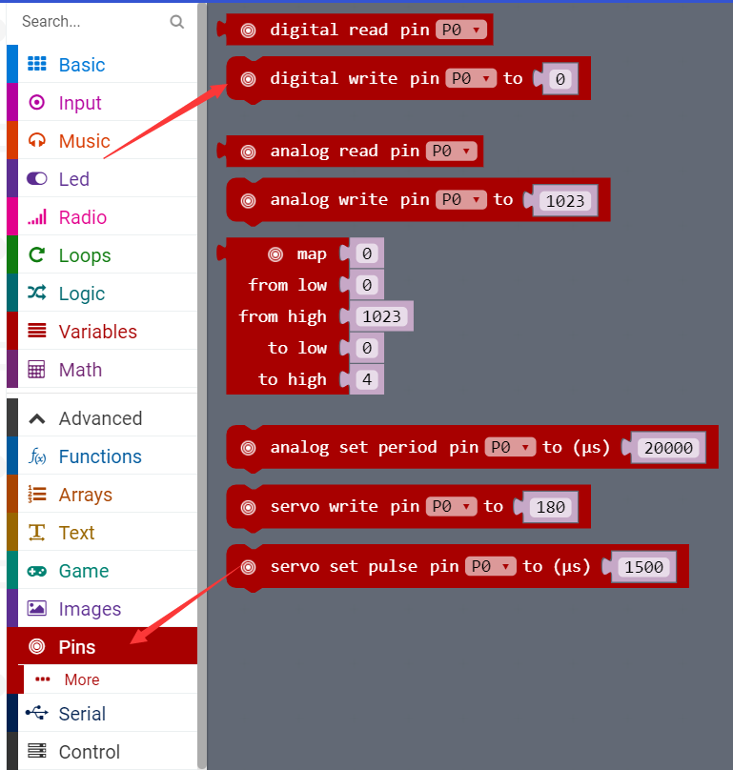
micro:bit entry video tutorial
Part 4
Search for blocks
YahBoom micro:bit module tutorial

Slide 16
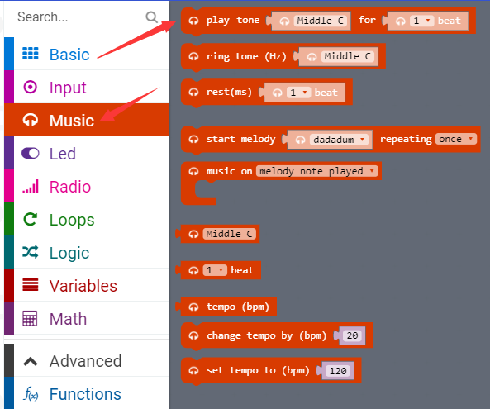
micro:bit entry video tutorial
Part 4
Search for blocks
YahBoom micro:bit module tutorial

Slide 17
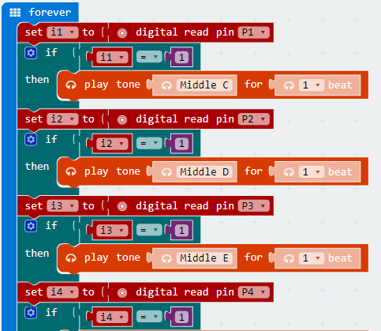
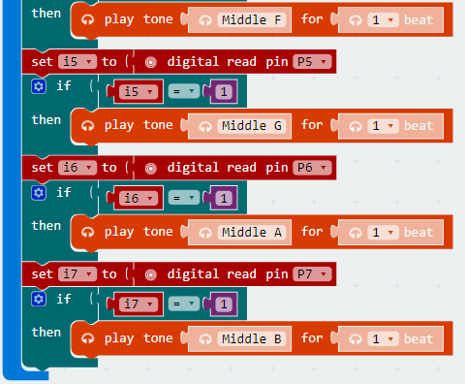
micro:bit entry video tutorial
Part 5
Combine blocks
YahBoom micro:bit module tutorial

Slide 18
micro:bit entry video tutorial
micro:bit
project
Thanks for watching！
Powered by YahBoom
YahBoom micro:bit module tutorial

